Slide 1
Traffic Analysis of Pacific Coast Highway city of Malibu
2013 - 2023

Slide 2
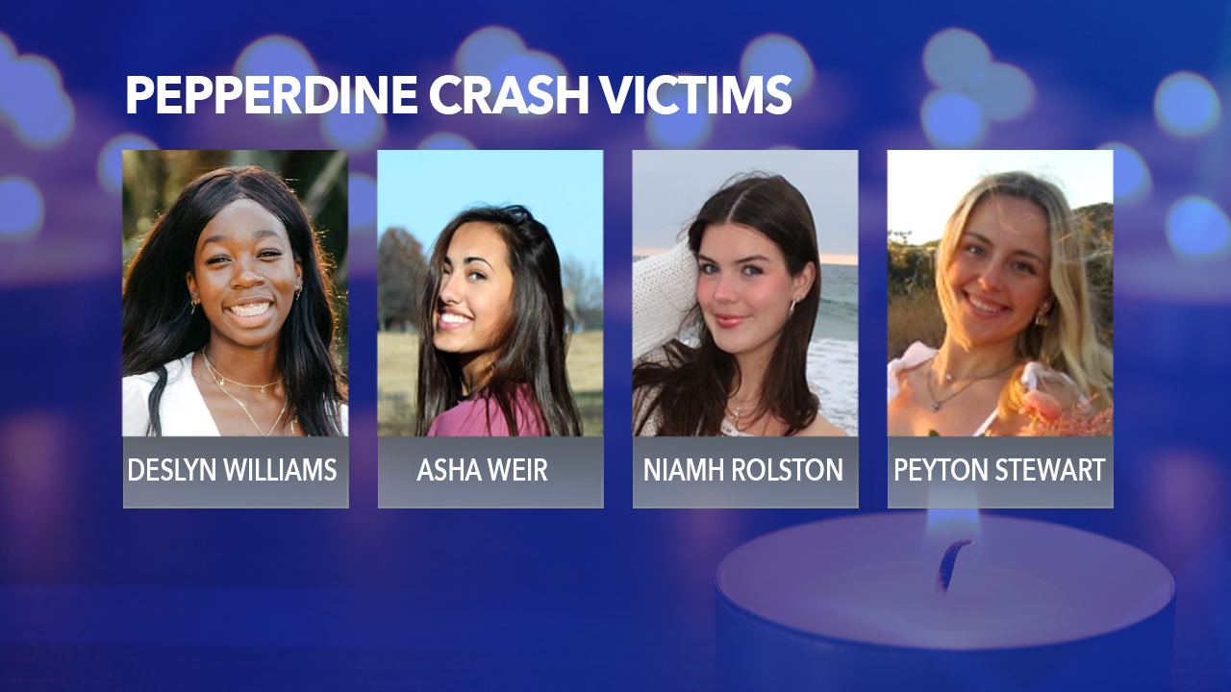
You have the power to save lives

Slide 3
2023 Collisions on PCH (Malibu)

Slide 4
2013 – 2023 Crash Data for PCH (3,345 Total Collisions)

Slide 5
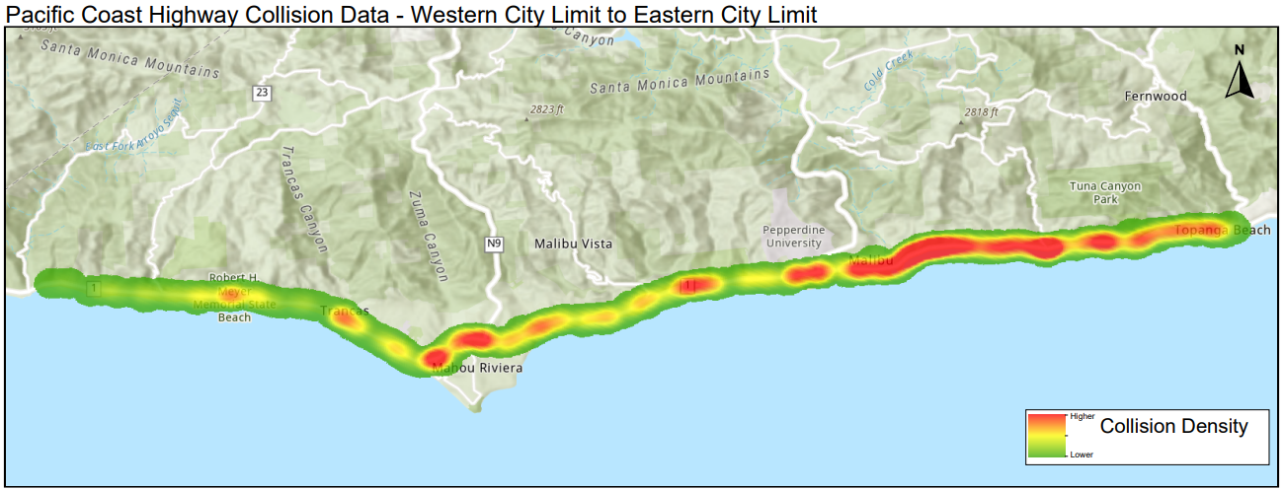
Collision Heat map of PCH
(January 2013 – September 2023)

Slide 7
Crash data from 2013 – 2023 (3,345 Total Collisions)

Slide 8
3,345 Total Collisions

Slide 9
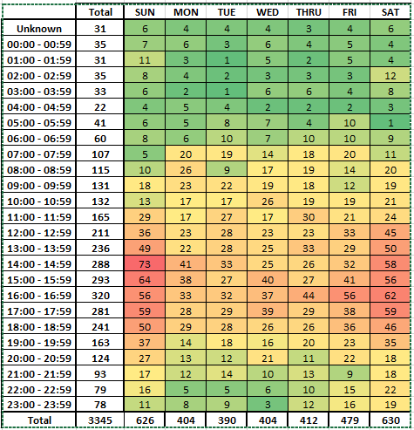
Day of Week and Time of Collisions for the last 10 years

Slide 10
Law Enforcement’s Actions :
42,102 Speeding citations issued in Malibu
Operations to target the Primary Collision Factors
Speed Operations
Pedestrian right of way operations
Bicycle enforcement operations
Distracted Driver operations (Cellphones)
Motorcycle operations
DUI Saturation
DUI Check points
S.T.E.P program
PSA at schools – Safe Driving
BUT IT’S NOT ENOUGH

Slide 11
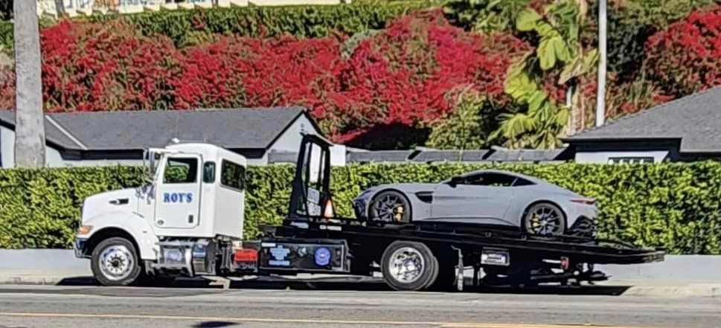
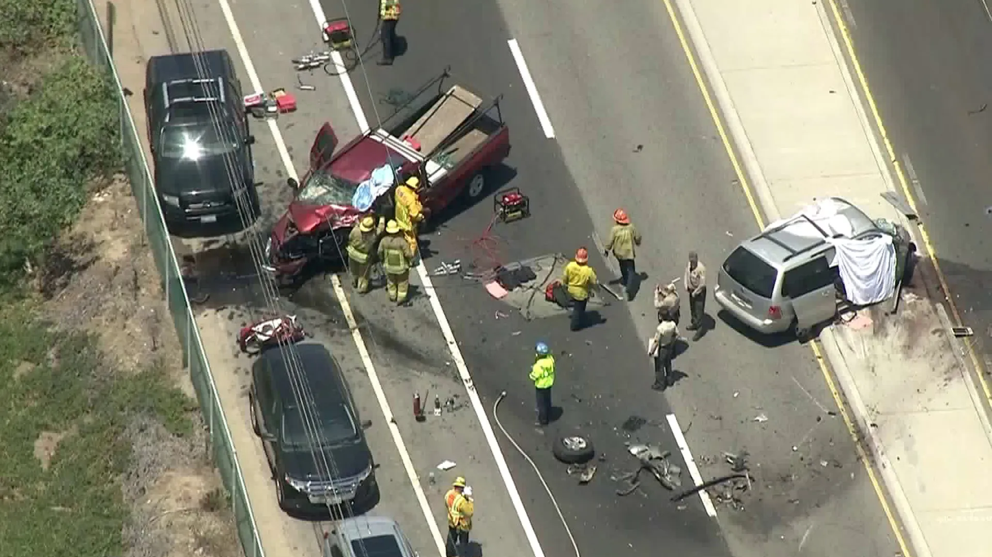
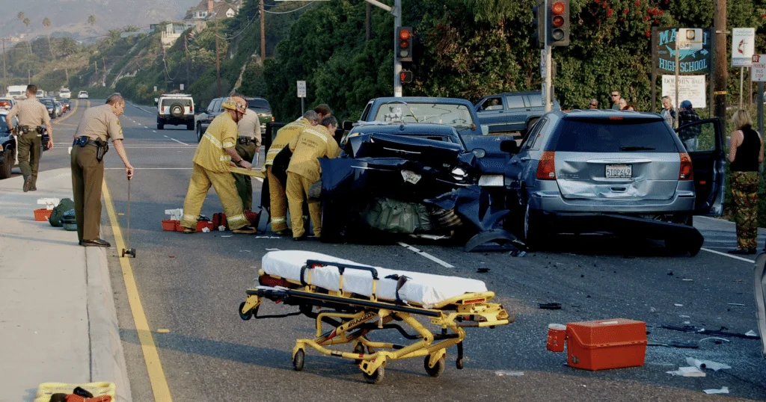
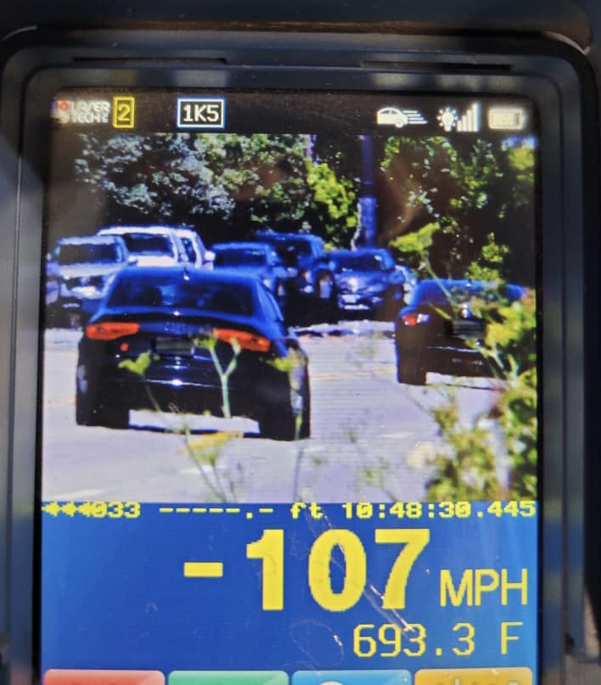
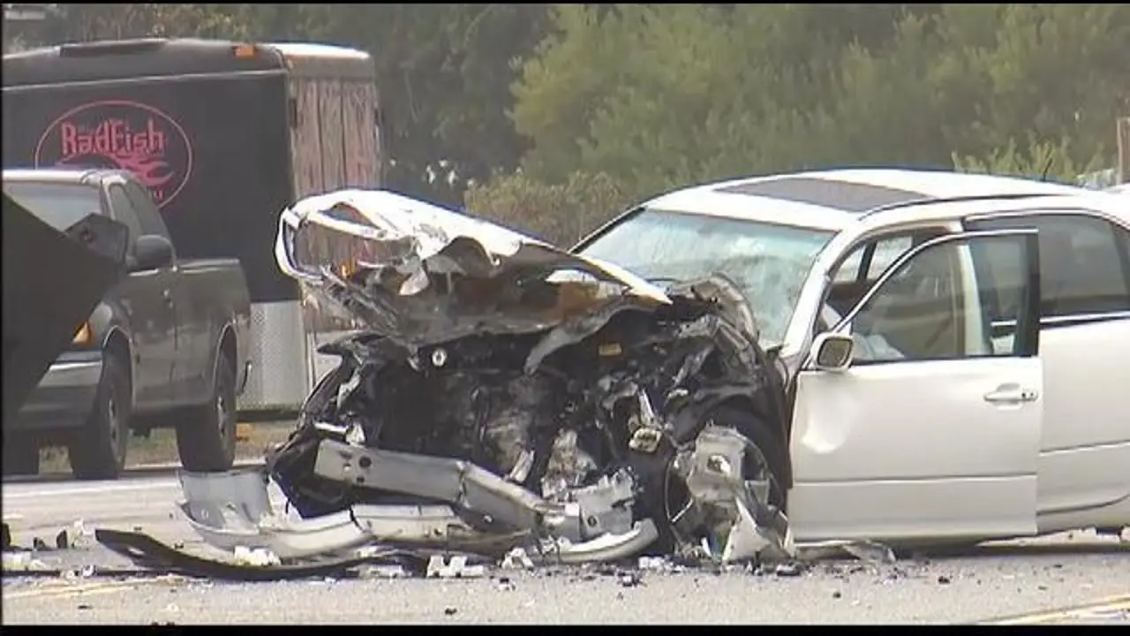
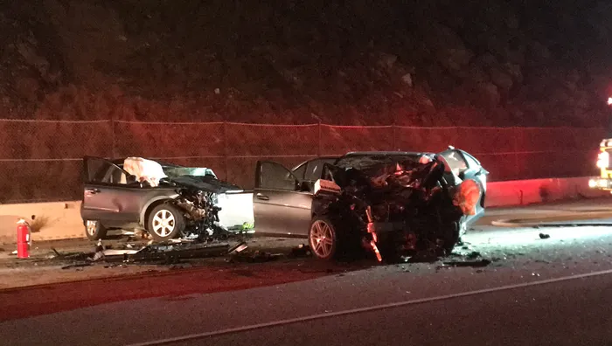
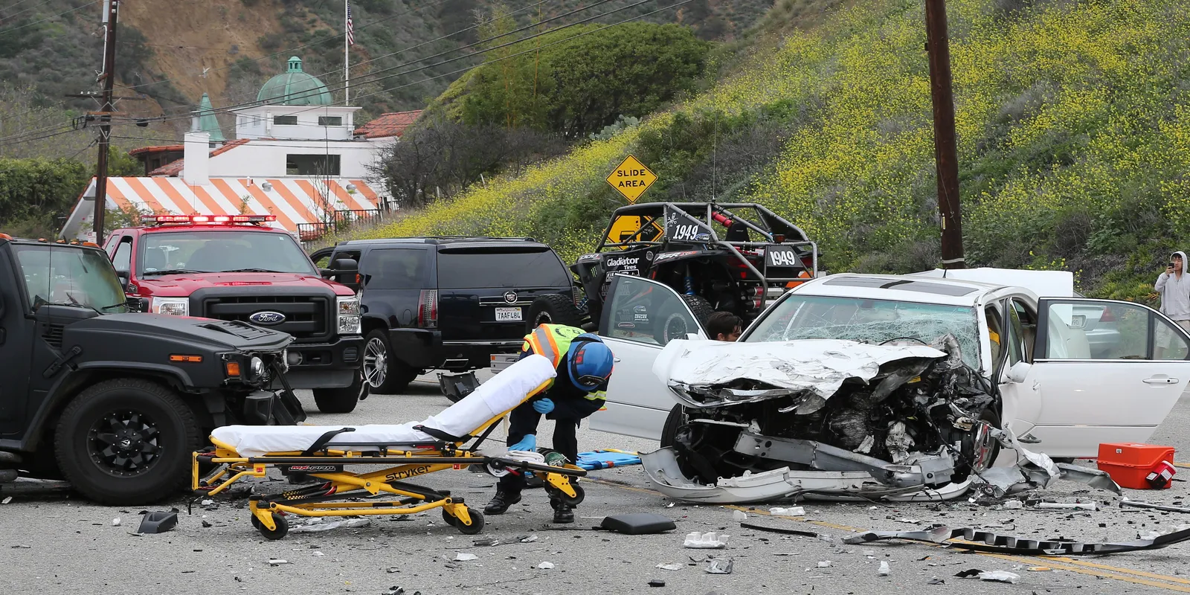
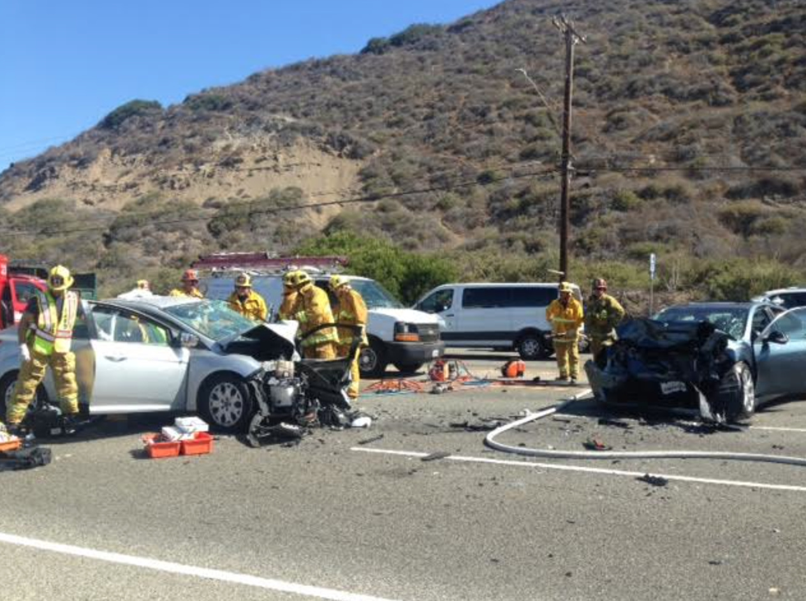
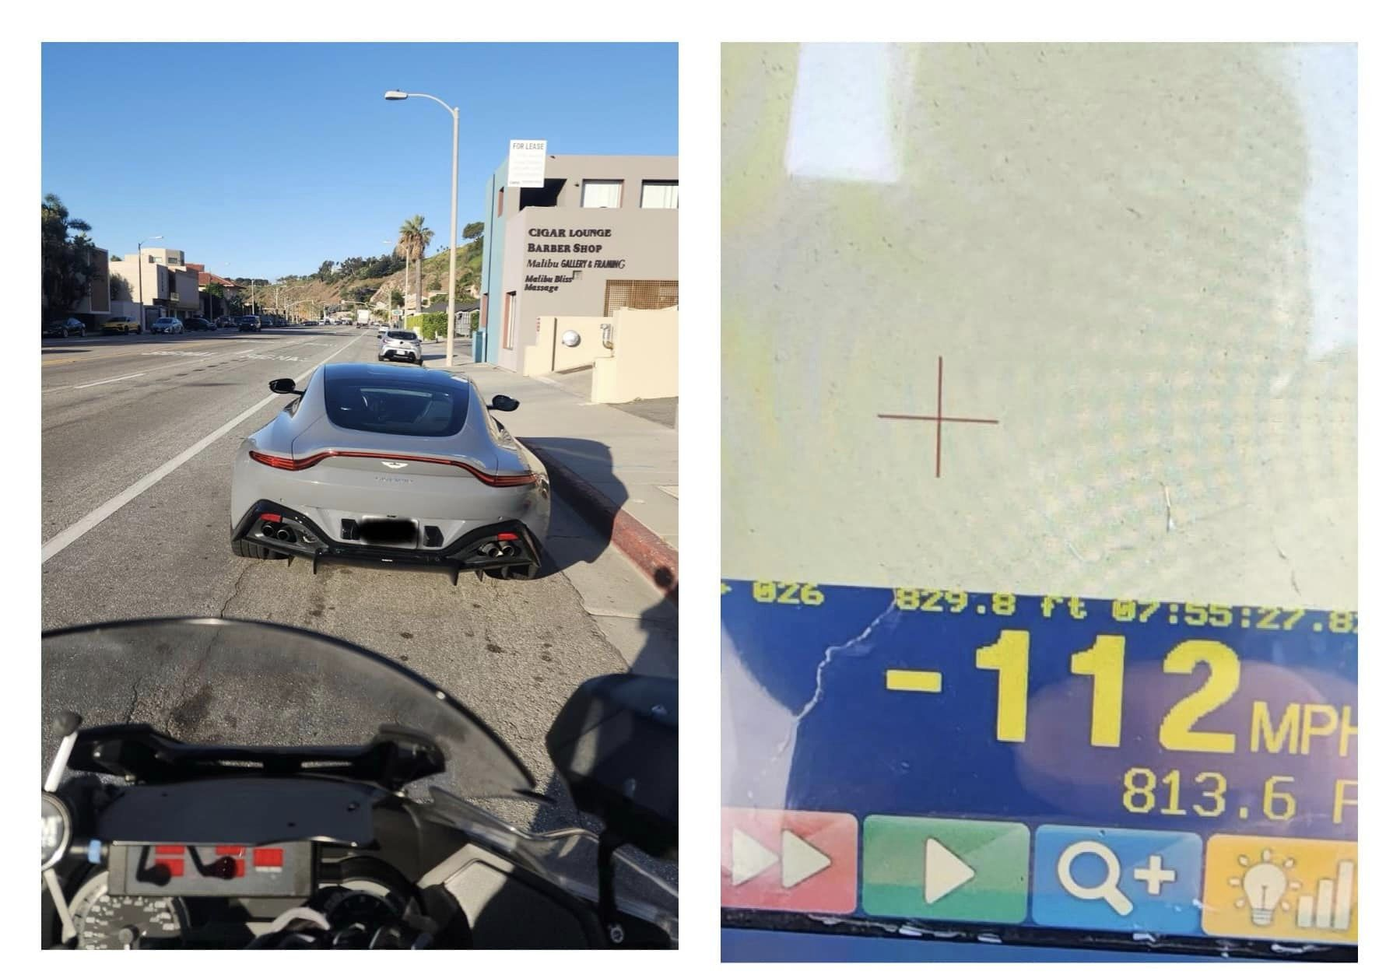
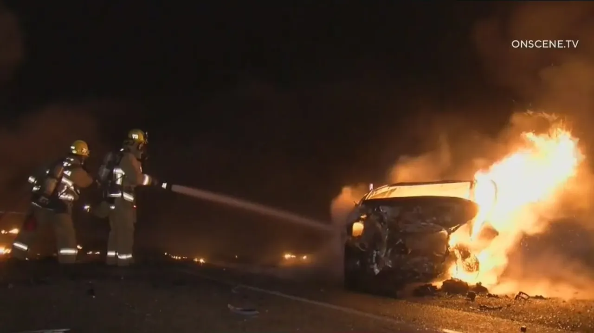
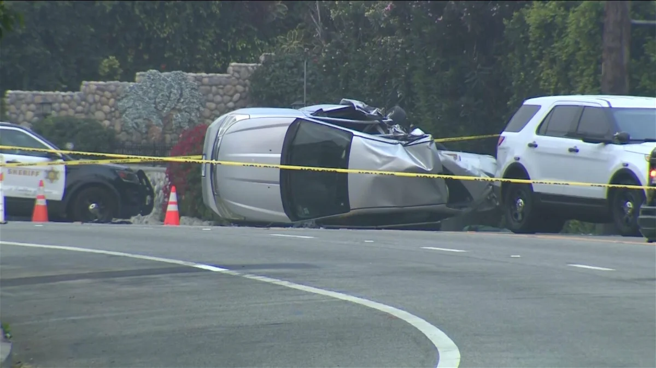
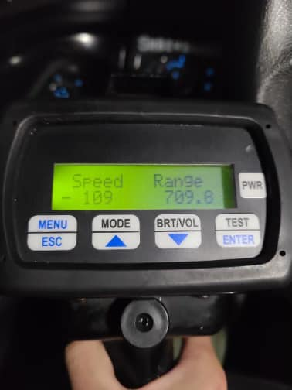

Slide 12
Law Enforcement cannot be the only answer!
We stand ready to work with:
Caltrans
Elected Officials
City of Malibu
Fix PCH grassroots Community Group
Community Leaders
Business Owners
Schools

Slide 13

Important Videos regarding the dangers on PCH:
21 Miles in Malibu – Trailer

Slide 14
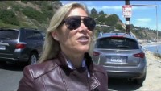
Important Videos regarding the dangers on PCH:
A Safer PCH – Teri Love

